Slide 1
Conditional Probability & Bayes Theorem
Jithin J Kumar

Slide 2
Conditional Probability
Events can be "Independent", meaning each event is not affected by any other events.
Example: Tossing a coin.
But events can also be "dependent" ... which means they can be affected by previous events …
Example: Marbles in a Bag, 2 blue and 3 red marbles are in a bag.Probability of blue marble is ⅖. Probability of next blue marble is only ¼.
This is because we are removing marbles from the bag. So the next event depends on what happened in the previous event, and is called dependent.

Slide 3
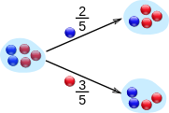
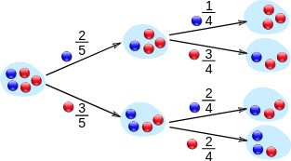
Conditional Probability Using Tree Diagram
Probability of Event C : to pick a Blue ball after A = 1/4
Probability of Event D: to pick a Red ball after A
= 3/4
Probability of Event C: to pick a Blue ball after B
= 2/4
Probability of Event D: to pick a Red ball after B
= 2/4
Probablitiy of Event B : to pick a red ball
p(B)=⅗
Probability of Event A : to pick a blue ball
p(A) = ⅖
Probablitiy of Event B : to pick a red ball
p(B)=⅗

Slide 4
Notation
P(A) means "Probability Of Event A".
P(B|A) means "Event B given Event A".
event A has already happened, now what is the chance of event B?
P(B|A) is also called the "Conditional Probability" of B given A.
Questions
What is the probability of drawing a blue ball after Event A ? [p(C/A)]
What is the probability of drawing a blue ball after Event B ? [p(C/B)]
What is the probability of drawing two blue balls after event A? p[E/A]
What is the probability of drawing two blue balls after event B ? p[E/B]

Slide 5
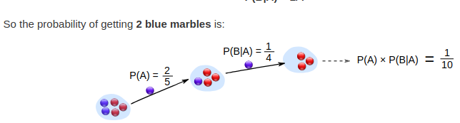
Conditional Probability
What is the probability of getting 2 blue balls ? [ P(A and B) ]
P(A) and P(B) : A - getting a blue ball in first draw, B-getting a blue ball in second draw without replacement
p(A)= ⅖ ; p(B)= ¼

Slide 6
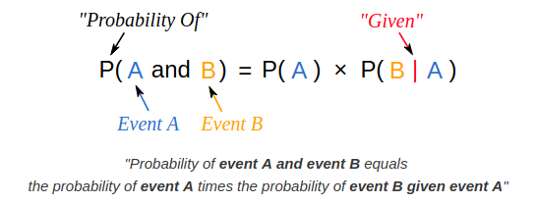
Probability of A and B : Mathematical Notation

Slide 7
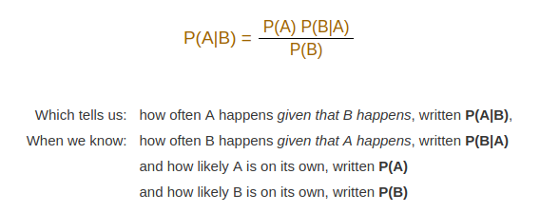
Bayes Theorem
Bayes theorem is a way to find probability if we know a ‘certain’ other probabilities

Slide 8
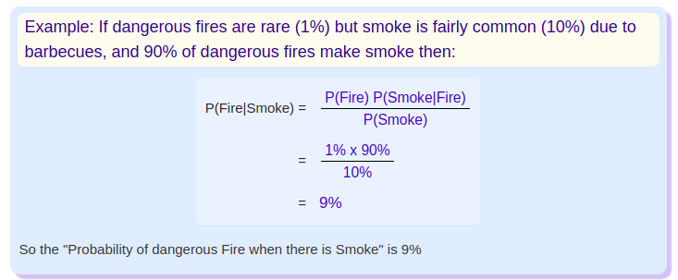
Bayes theorem Example

Slide 9
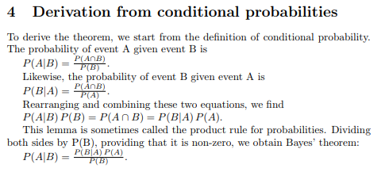
Bayes Theorem : Derivation

Slide 10
Thank You..!
Questions please..! :)

